Slide 1
Topic: Bangla Interrogative Sentence Identification from Transliterated Bangla Sentences
Members
Supervisor
Md Forhad Rabbi,PhD
Associate Professor
Department of CSE,SUST

Slide 2
What is Transliterated Bangla?
Using Latin alphabet for writing Bangla
Example:
The Bangla sentence “বাংলাদেশের খেলা কখন শুরু হবে?”
is written in the transliterated Bangla as:
“Bangladesher khela kokhon shuru hobe?”

Slide 3
Motivation
Most Popular Way of writing Bangla in internet.
An unscratched field of research.
Huge content generation on daily basis.
Analyzing human behavior from the web content.

Slide 4
Related Works
C. Gao, C.-Y. Lin, Y.-I. Song, and Y. Sun, “Finding question-answer pairs from online forums”. Obtained accuracy: 88%.
K. Wang and T.-S. Chua, “Exploiting salient patterns for question detection and question retrieval in community-based question answering”. Obtained accuracy: 92%.
B. Li, X. Si, M. R. Lyu, I. king, and E. Y.Chang, “Question identification on twitter”. Obtained accuracy: 72%.
S. Banerjee and S. Bandyopadhyay, “An empirical study of combining multiple models in Bengali question classification”. Obtained accuracy: 87%.
Y. Kim, “Convolutional neural networks for sentence classification”. Obtained accuracy: 72%.

Slide 5
Challenges
Huge Variation
No Grammar
Less Research

Slide 6
Data Collection
6 different cricket related Facebook public groups
Via Google form.
SUST admission test related data.
Using https://grytics.com , a free website for data extraction from Facebook public groups.
Around 50,000 comments.

Slide 7
Primary Corpora
Corpus | Corpus Information
 | Number of Sentences | Number of Words
Primary Corpus | 29,883 | 145,009
Interrogative Mega Corpus | 4,624 | 23,785
Other Mega Corpus | 25,259 | 121,224
Interrogative Corpus | 700 | 3,073

Slide 8
Data Analysis
Average number of words, letters per sentence.
Average number of Letters per Word per sentence.
Position of Bangla question words in the sentence.
Average position of question words in the sentence.

Slide 9
Interrogative Corpus Analysis
Average Number of Words | 4.7
Average number of Letters per Word | 4
Average Number of Letters | 19
All the averages denotes the average per sentence

Slide 10
Bangla Question Word List
Ki, Keno, Kivabe, Kothay, Koto, Kar, Kon,
Kobe, Kisher, Kokhon, Ke, Kemon, Koy,
Ke Ke, Kake, Kara, Kader, Koi, Koyta, Kotha.

Slide 11
Position of Bangla Question Word
Position of Bangla Question Word in Sentences | Corpus Information
 | No. of Sentences
1st Word | 112
Last word | 171
2nd Word | 167
3rd Word | 37
4th Word | 4
5th Word | 4
6th Word | 2
7th Word | 1
8th Word | 1
Just Before the Last Word | 52
mean position: 1.90

Slide 12
Formation of Secondary Corpus
Total Sentences | 8797
Interrogative Sentences | 1704
Non-Interrogative Sentences | 7093

Slide 13
Formation of Tertiary Corpus
Total Sentences | 11790
Interrogative Sentences | 4138
Non-Interrogative Sentences | 7652

Slide 14
Approach of Detection
Rule
Based
Approach
Deep Learning
Approach
Learning
Based
Approach

Slide 15
Rule Based Approach
Rule 1: A Bangla question word is present as the first or last word of a sentence.
Rule 2: A Bangla question word is present as the second word of the sentence and the first word is the subject or object of the sentence.
Rule 3: A Bangla question word is present just before the last word of the sentence.
Rule 4: The word “Naki” is considered as a question word and the sentence with this word follows the previous rules.

Slide 16
Rule Based Approach Findings
Method | Accuracy %
Rule 1 | 40.42
Rule 1 + Rule 2 | 64.29
Rule 1 + Rule 2 + Rule 3 | 71.71
Rule 1 + Rule 2 + Rule 3 + Rule 4 | 75.14

Slide 17
Evaluation of Rule Based Approach
The accuracy is low and biased.
Impractical and not pragmatic.
Not able to address the deviation.

Slide 18

Machine Learning
Approach

Slide 19
Machine Learning Approach
Supervised
Learning
Deep
Learning

Slide 20
Supervised Learning Approach
K-NN
SVM
MLP
LR

Slide 21
Supervised Learning
Secondary Corpus

Slide 22
8797
7093
30%
Number of Sentences
Non-Interrogative Sentences
Test Data

Slide 23
Accuracy Finding on Secondary Corpus

Slide 24
Supervised Learning
Tertiary Corpus

Slide 25
11790
4138
Admission Data
Number of Sentences
Interrogative Sentences
Training Dataset

Slide 26
Accuracy Finding on Tertiary Corpus

Slide 27
Evaluation of Learning Based Approach
Secondary Corpus
Test data and training data are from same domain
Accuracy level is high
Tertiary Corpus
Test data is from another domain
Accuracy level drops

Slide 28

Deep Learning
Approach

Slide 29
Deep Learning Approach
Forming Convolutional Neural Network (CNN)
Tertiary Corpus as the working dataset.
10% of the dataset as the test dataset.

Slide 30
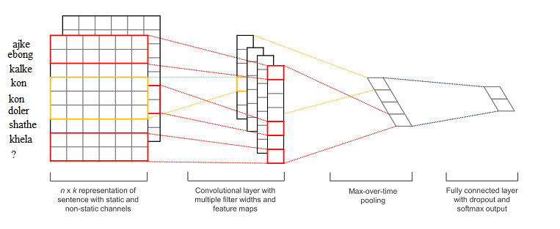
CNN Model for Classification

Slide 31
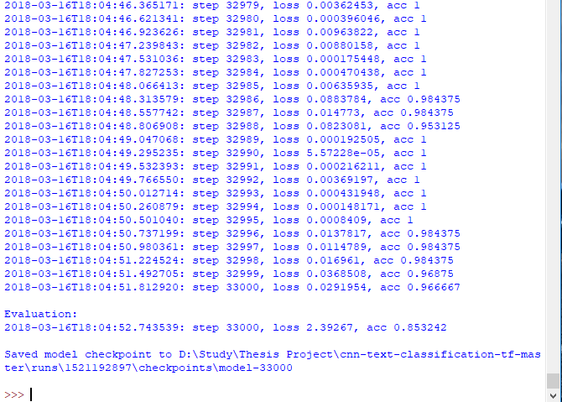
Training Steps For CNN

Slide 32
Findings After Training
33,000
Training Steps
Accuracy: 85.32 %

Slide 33
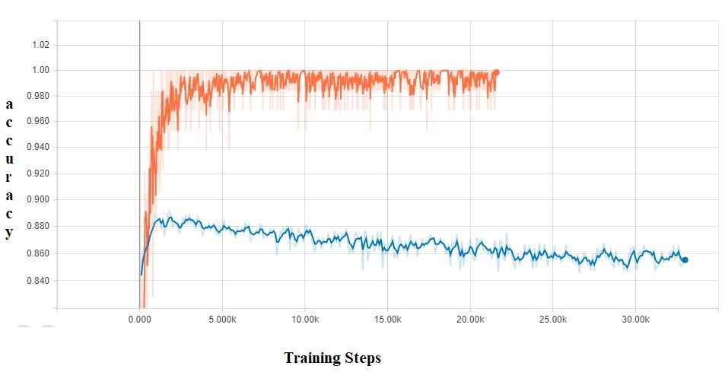
Graphical Representation of CNN Model
Training Data
Test Data

Slide 34
Insights of CNN
Accuracy
85.32 % accuracy.
Overfitting
As the blue line is bellow than the red line in the previous graph, the model was overfitted due to the presence of less data
Best Method
In terms of accuracy, the CNN gives us the best way of classification.

Slide 35
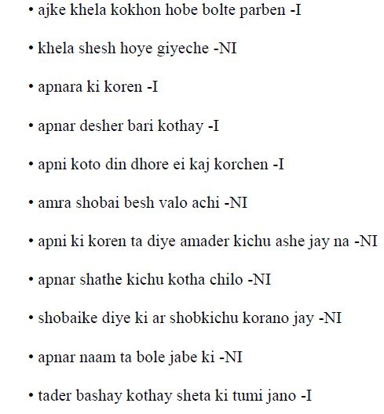
Classifying Sentences Using our CNN Model
I = Interrogative
NI = Non-Interrogative

Slide 36
Classification Success
Using our model we can classify sentences like the followings:
ajka kala kokhan (ajke khela kokhon) -I.
“ame ajka kala dekba (ami ajke khela dekhbo)-NI”

Slide 37
Classification Failure
Our Model failed to classify sentences like bellow:
Apnar shathe amader dekha holei ki na holei ba ki
Ajke Brishti porte pare kina sheta jante chaile ki dhoroner kaj kora lagbe?

Slide 38
Evaluation of All Approaches

Slide 39
Future Work
Enriching the dataset to avoid overfitting.
Applying Recurrent Neural Network(RNN) for classification.
Designing a question-answering system for transliterated Bangla.
Using Generative Adversarial Network(GAN) for answer generation

Slide 40
Acknowledgement
We express cordial gratitude to our supervisor Md Frohad Rabbi,PhD, Associate Professor, Sabir Ismail, Assistant Professor,
and Md Mahfuzur Rahman, Assistant Professor, Department of Computer Science
and Engineering, Shahjalal University of Science and Technology for their prudent advice
and guidance.

Slide 41
Thank You

